Slide 1
Octank America
Real time HVAC monitoring
David Laredo – Prototyping Architect
Mar 2021

Slide 2
Agenda
HVAC 101
Octank’s HVAC system
Proposal
Demo
Architecture
Generated value
Next steps

Slide 3
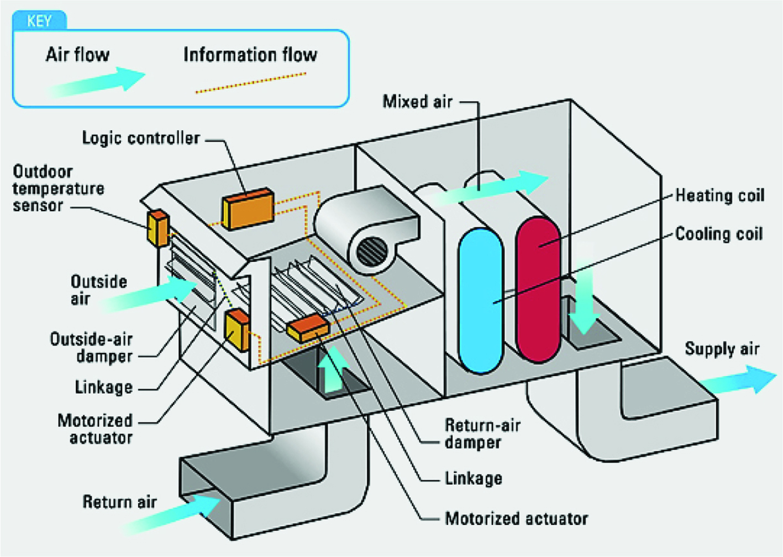
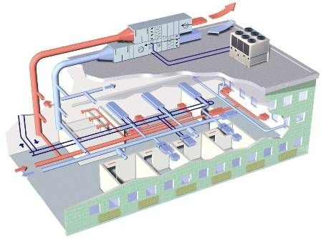
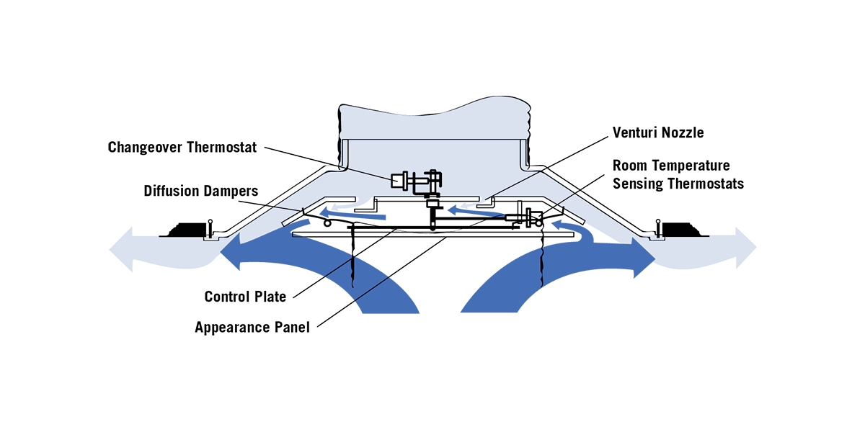
HVAC 101
Notes:
The purpose of HVAC system is to provide and maintain environmental conditions , including proper airflow, heating, and cooling within a certain area.

Slide 4
HVAC Monitoring
HVAC is a major energy consumer
Failures compromise occupant confort
Air quality needs to be kept at specific levels for certain manufacturing processes
HVAC are complex systems
Its hard to isolate failures within the system
Rule based approaches may not be very accurate
High volume of data

Slide 5
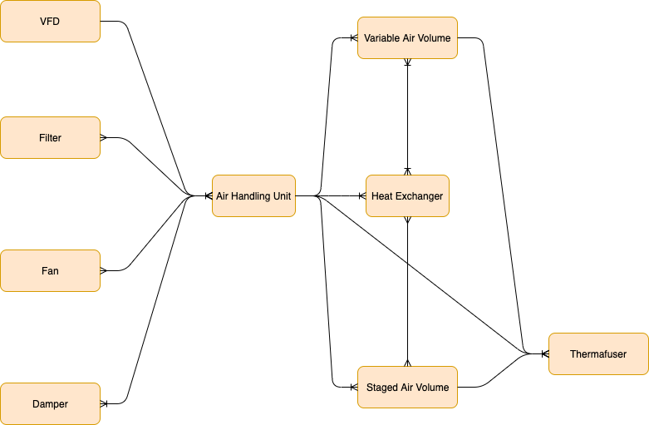
Octank America’s HVAC layout
4 AHUs
More than 100 thermafusers
Around 50 components such as dampers, heat exchangers, filters, etc
Close to 800 different sensors

Slide 6
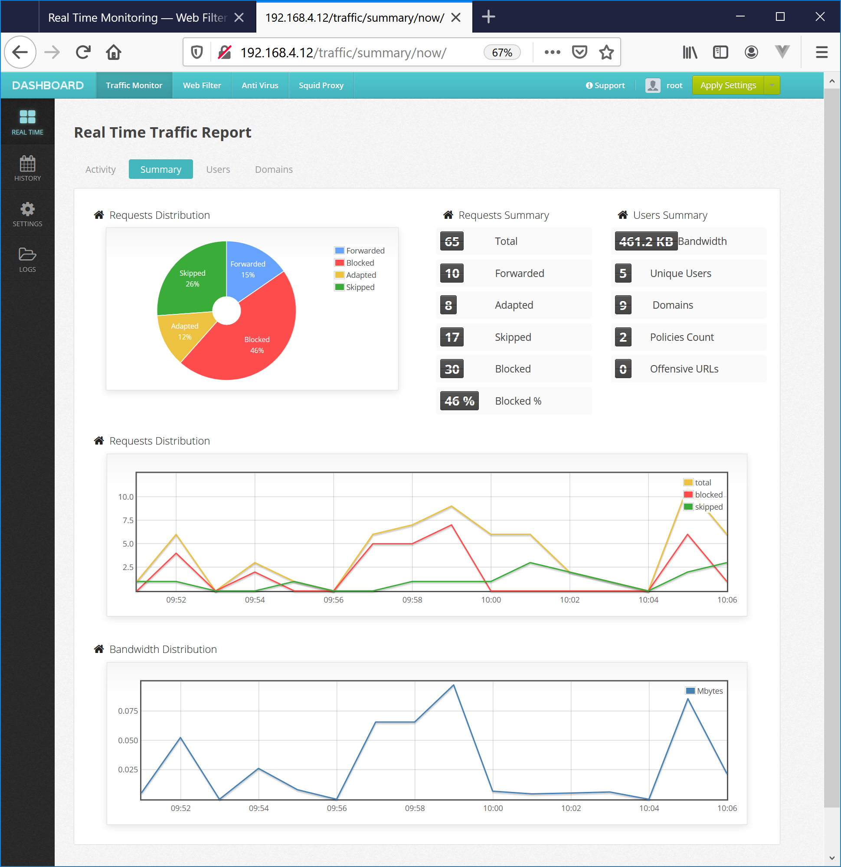
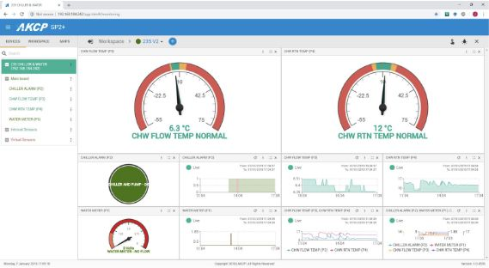
HVAC System Observability
Can monitor in real time the status of the system
Real time notifications of anomalyes
BI dashboards for management team
Highly scalable and reliable

Slide 7
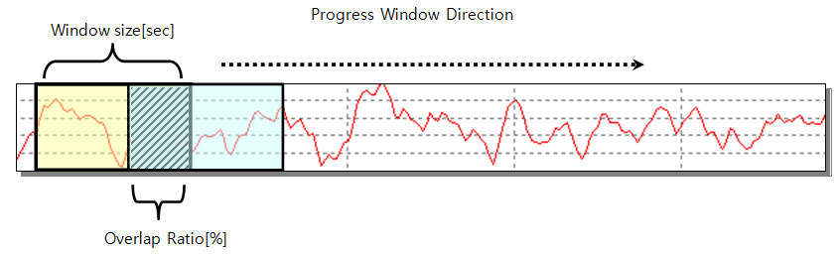
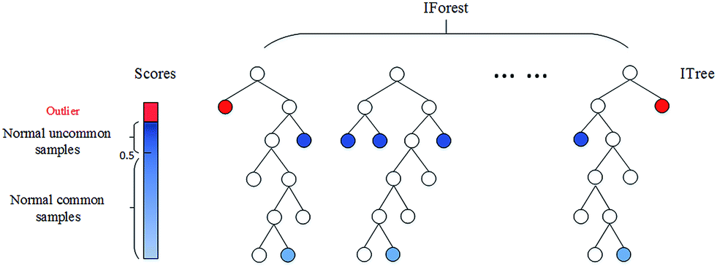
Anomaly detection
Data is not labeled
Detect anomalies in the process
Systemic detection
Moving window based approach
Isolation forest
For the PoC we only considered one single thermafuser for data training

Slide 8
Demo

Slide 9
Architecture

Slide 10

















HVAC System Monitoring
AWS Cloud
Corporate
data center
Crawler
AWS Glue Data Catalog
AWS Lambda * Data Transformation
Amazon Simple Storage Service (Amazon S3)
AWS Glue
Amazon Athena
Amazon QuickSight
HVAC Client
Amazon SageMaker
* Custom model
AWS Lambda * Update partitions
Amazon Kinesis Data Firehose
Amazon SSO
Users
HVAC Client
AWS Lambda
*Detect anomalies
Amazon Simple Notification Service (Amazon SNS)
HVAC Client
Amazon Timestream
Grafana

Slide 11
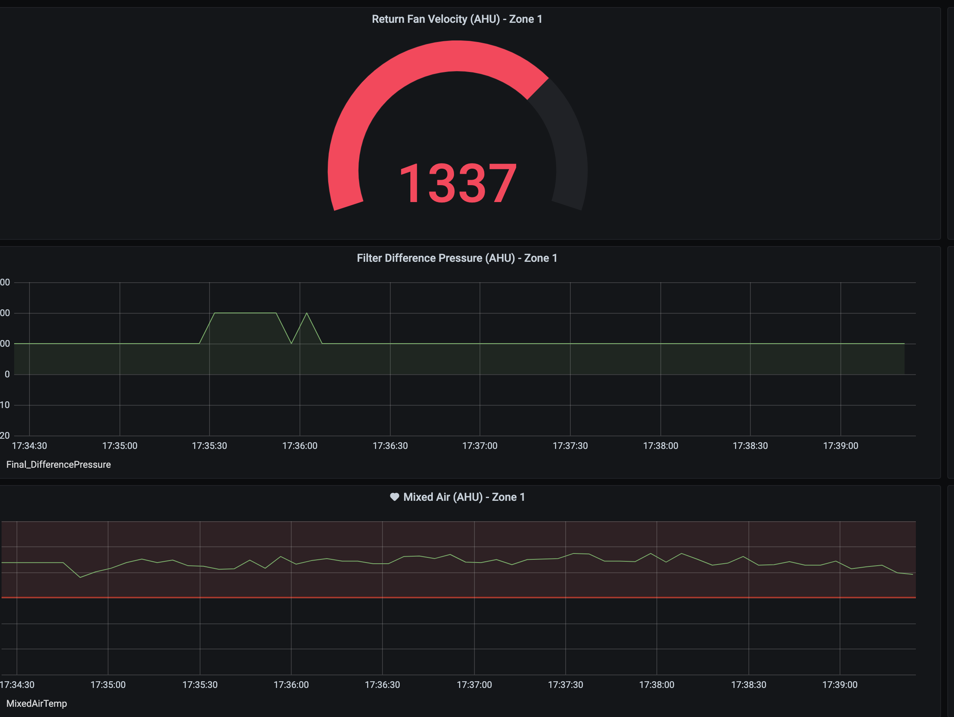
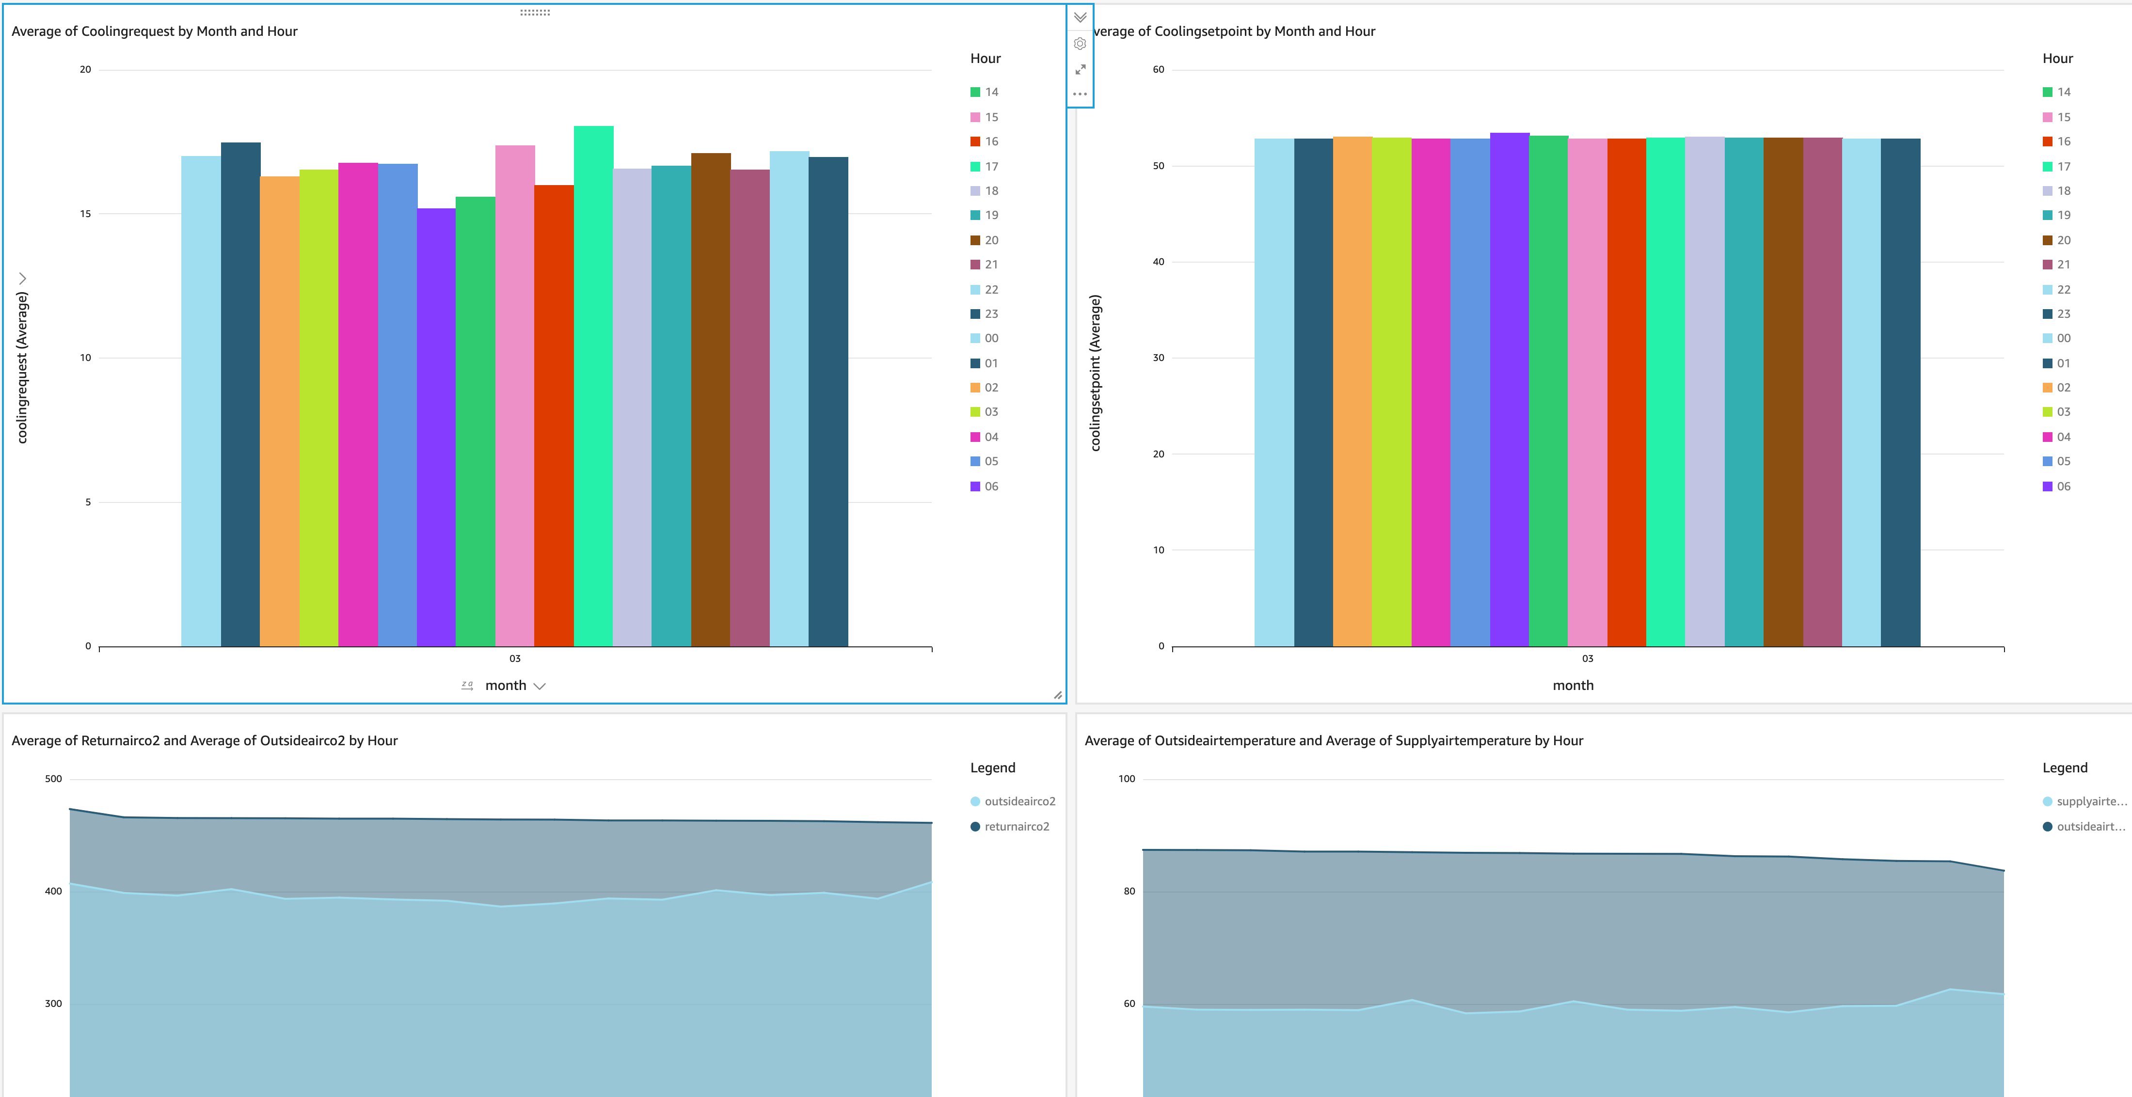
Benefits
Insights into the daily ops. of the system
Improve response time and increase performance
Increase lifetime of components
Consume energy more efficiently

Slide 12
Cost Analysis
 | Region | Oregon (us-west-2)
 | Service | Usage | $ Year
Store sensor records | Amazon S3 | 35 GB/month | 53
Pre-process records/send notifications | AWS Lambda | 3 req/record | 2000
Time series data | Amazon Timestream | 1 insert/record | 515
Stream data | Amazon Kinesis Firehose | 1 insert/record | 12
Time series visuals | Grafana | 2 licenses/month | 180
BI dashboards | Quicksight | 50 readers/month | 1320
Anomaly detection | Amazon SageMaker | 1 instance/month | 1080
 |  |  | 5000 USD / Year
1) Assuming data is recorded every 5 minutes
2) Assuming 35 GB of data per month: Largest object is 1KB (5 KB) * 800 * 12 * 24 * 30 = 34.5 GB/Month.
3) Configuring lifecycle policies
4) 7 days of data in-memory and 1 month of magnetic storage
Notes:
Firehose is priced based on volume of ingested data per month. Number of data records you send to the service, times the size of each record rounded up to the nearest 5KB (5120 bytes)
1 + 2 +3 + 4 +5 +6 = 21*2 = 42 GB per year in Standard. 21 GB per year in infrequent access
Lambdas: 100ms avg for extract keys every 5 min * 9, 300ms for updating partitions every 5 min * 9, 9500ms for inference every 10 minutes * 9
900ms + 2700ms + 85500ms = 90000 ms every 5 minutes

Slide 13
Cost Analysis
Data per month: Largest object is 1KB (5 KB) * 800 * 12 * 24 * 30 = 34.5 GB/Month.
Firehose: 1 USD/Month per 800 sensors every 5 minutes. 12 USD per year
S3: 1 USD/Month per 800 sensors every 5 minutes. 21*2 + 11 = 53 USD per year
1K per 5 min. 8640 per Month. 104,000 per year = 40 USD per year
Glue: Costs are negligible for data catalog and crawlers
Athena: 5.00 per TB scaned. We used partitions and compression
Quicksight (50 readers): 110 per month. 1320 USD per year
Notes:
Firehose is priced based on volume of ingested data per month. Number of data records you send to the service, times the size of each record rounded up to the nearest 5KB (5120 bytes)
1 + 2 +3 + 4 +5 +6 = 21*2 = 42 GB per year in Standard. 21 GB per year in infrequent access
Lambdas: 100ms avg for extract keys every 5 min * 9, 300ms for updating partitions every 5 min * 9, 9500ms for inference every 10 minutes * 9
900ms + 2700ms + 85500ms = 90000 ms every 5 minutes

Slide 14
Cost Analysis
Lambda (only PoC): 90,000ms every 5 min. 20 USD per year. 2000 USD per year for 800 sensors
Timestream: 7 GB in Memory = 504 USD/Year, 28 Gb Magnetic = 10 USD/Year,
Sagemaker Inference: 90 USD/Month. 1080 USD/Year.
SNS: Costs are negligible (2 USD per 100000 notifications)
Cognito: Costs are negligible
Grafana:
Total: 5000 USD per year for 800 sensors
Notes:
Firehose is priced based on volume of ingested data per month. Number of data records you send to the service, times the size of each record rounded up to the nearest 5KB (5120 bytes)
1 + 2 +3 + 4 +5 +6 = 21*2 = 42 GB per year in Standard. 21 GB per year in infrequent access
Lambdas: 100ms avg for extract keys every 5 min * 9, 300ms for updating partitions every 5 min * 9, 9500ms for inference every 10 minutes * 9
900ms + 2700ms + 85500ms = 90000 ms every 5 minutes

Slide 15


Next Steps
Path to Production
Handover
Transfer to your account
Integration

Slide 16
Innovate. Experiment. Explore.
Thank you.
David Laredo
razodav@amazon.com

